Slide 1


Orphan’s Home

Slide 2
Group members’ list
NAME | ID
1. KHAN, TASNEEM ISLAM | 19-40416-1
2. KAMAL, TASNUBA | 19-39741-1
3. KHONDOKAR, MAHJA BIN | 19-40439-1
4. REZA, S. M. ASHIL | 19-40455-1

Slide 3

Project Motivation
Motivation
Our project is on Orphanage Management System. This system is mainly to make the work easier for orphanage and also to help the orphan . Through this system Orphanage can easily keep the record of the orphans . Through this system they can also connect to people those who want to do donation or want appointment to meet a child for adoption.

Slide 4

Project Objective
Objective
This system will help the orphanage manager and admin to keep the orphans details , can search any orphans details easily from the record , also can keep the record of donation. Through this system another user can be also benefited and they are out of orphanage management system they will be client . And client can easily donate to the orphanage and also can take appointment. Client donation details will be kept as a record in to the system and orphanage admin can see the donation records.

Slide 5

Project Details
1. User
2. Functionalities
3. Contribution

Slide 6

USERS
In our project we have mainly 3 users
1. Admin
2. Orphans Manager
3. Client

Slide 7
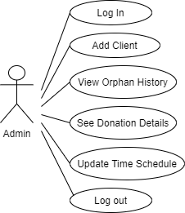
ADMIN
Through this system admin first have to log in to the system after login admin responsibility to add new clients , also can see orphans details and donation information client details, admin also have ability to update time schedule.
So, the functionality of admins are
1. Login
2. Add new clients
3. View orphans details
4. View donation details
5. Update time schedule
6. Logout

Slide 8
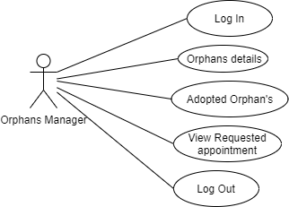
Orphans Manager
Orphans manager main responsibility is to manage the orphans details . Orphans manager can add new orphans , Mange adopted orphan's details also can see requested appointment.
So, the functionality of orphans manager are
1. Log in
2. Orphans details
3. Adopted Orphans
4. View Requested Appointment
5. Logout

Slide 9
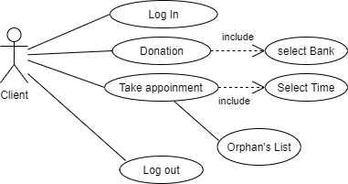
CLIENT
After Login Client can see Two Option Donation and Adoption Appointment
So if client choose Donation option than there will be some online Banking System Option will be given through which client can do their online donation If the client choose adoption option then for taking appointment client can select the appointment time through time schedule which will be provided by the system. Client can also see the orphans details.
So , The Functionalities of clients are
1. Log in
2. Make Donation
3.Take Appointment
4. Logout

Slide 10
Contribution
NAME | TASK
1. KHAN, TASNEEM ISLAM | Code writing and Error fixing
2. KAMAL, TASNUBA | Code writing and Error fixing
3. KHONDOKAR, MAHJA BIN | Code writing and Error fixing
4. REZA, S. M. ASHIL | Code writing and Error fixing

Slide 11
Limitation
1. UI design could be more better and professional.
2. Client functionality could have been more better.
3. In this project we can do more better if we have more time.

Slide 12
FEEDBACK
Through this system Client can take online appointment and also can choose orphans for their first meet and all the orphans details can be keep on track .So this are some positive side of the system .
In future we can work with this project but for that obviously we need to do some changes we need to update the functionality to make it look and use professionally. Now in this project only with 3 used functionality has been show but to run an orphanage there are more people so more user functionality can be added

Slide 13
Thank You

